Slide 1
Linear Regression
For used car market in UK

Slide 2
Outline :
Summary
Data Description
Introduction
Linear Regression Model
Problem Understanding

Slide 3
Introduction :
Cars are one of the most important necessities for every family, as they are the most popular means of transportation these days.
Use the predict to help us to figure out the UK used car market, and the data was collected from Kaggle.

Slide 4
Problem Statement :
This project aims to Predict the prices of used cars market in the UK, by engine size, and car model, type of transmissions etc, by linear regression.

Slide 5
Data Description :
Our data set is about most common cars brand in UK, and it contain two brands Ford and Volkswagen
The data set is provided in .csv format, contains information of price, transmission, model, mileage, year, engine size, mpg, fuel type.
Our data contains thirty-three thousand of rows and 8 columns of information of used Cars.

Slide 6
Linear Regression Model :
Test | Val | Train | Exp
74.11% | 73.65% | 75.21% | Baseline
87.95% | 88.11% | 88.30% | Dummy
92.21% | 92.36% | 92.45% | Log
92.37% | 92.37% | 92.57% | Coxbox
90.52% | 92.38% | 92.57% | STD

Slide 7
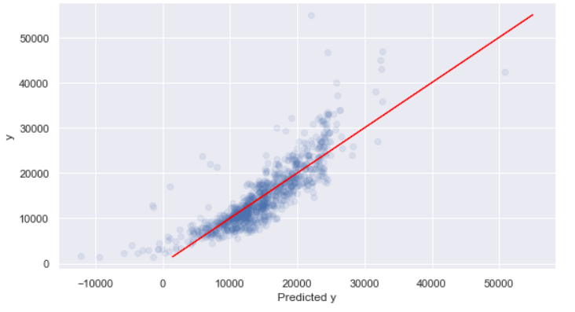
Linear Regression Model :
Baseline model plot

Slide 8
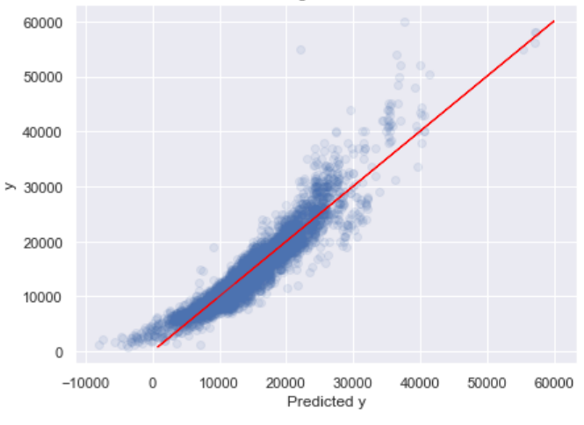
Linear Regression Model :
Dummy model plot

Slide 9
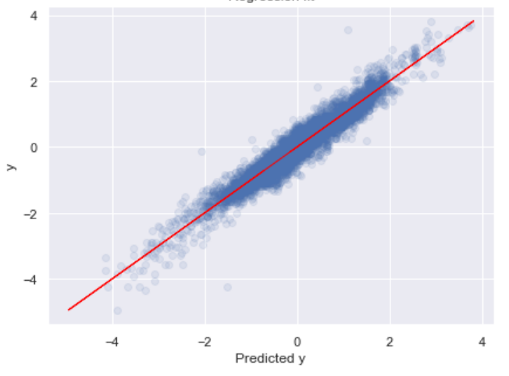
Linear Regression Model :
Coxbox model plot

Slide 10
Summary
The model is improved after using the Dummy Variable function.
We find The best model is Coxbox Model.
So , our model ready to predict the prices of used car.

Slide 11
THANKS !
Any questions?

